Slide 1


Creating your first webpage using HTML
Mandy Farrugia

Slide 2
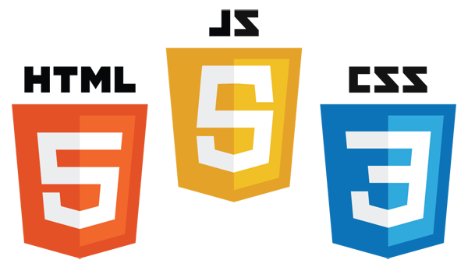
What are the most fundamental languages when it comes to the creation of websites?

Slide 3
HTML
HTML, short for HyperText Markup Language, is a markup language used to display documents on a web browser.
HTML is usually assisted by other web technologies such as CSS and JavaScript in order to render an attractive, responsive and functional/dynamic website.
HTML was invented by British computer scientist, Tim Berners-Lee. The World Wide Web (WWW) is also the brainchild of Tim Berners-Lee!

Slide 4

What is the World Wide Web/WWW/W3?
WWW refers to an information system in which documents and web resources are identified by a Uniform Resource Locator (better known as a URL such as https://www.bing.com/)
Web resources are subsequently transferred via HTTP (HyperText Transfer Protocol) and can then be accessed via a web browser. Said resources are first published by a software known as web server.
This concept was invented on 12th March 1989 and has recently reached its 32nd year since its release. Berners-Lee also collaborated with Belgian computer scientist, Robert Cailliau.

Slide 5
When was the first web browser released?
The very first web browser, WorldWideWeb although it was subsequently renamed to Nexus to avoid confusion between WWW and the web browser, was released on 25th December 1990, after two months of development, by Tim Berners-Lee, whilst working for the European nuclear research entity CERN.
WorldWideWeb was released to the public in August 1991.
It was discontinued in 1994, a few months after the final release 0.18 on 14th January 1994. The source code was publicly released on 30th April 1993.

Slide 6
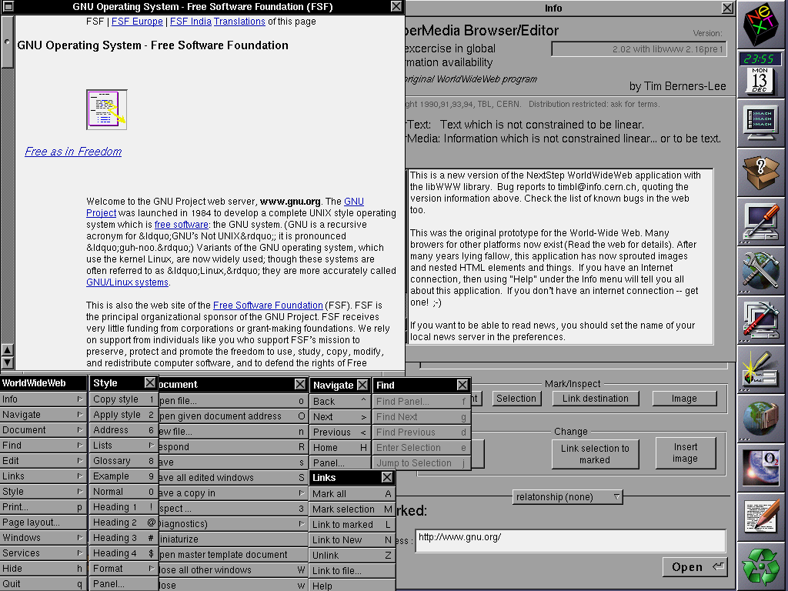
WorldWideWeb/Nexus pictured in 1994

Slide 7
What is HTML?
File extension | .html/.htm
Initial release | 1993
Developers | WHATWG
Official website | https://html.spec.whatwg.org/
WHATWG (an acronym for Web HyperText Application Technology Working Group) is a community interested in the enhancement of HTML and its related technologies. It was founded on 4th June 2004 by leading web browser vendors at the time, those being Apple Incorporations (developers of Safari), Mozilla Foundation (developers of Mozilla Firefox) and Opera Software (developers of Opera).

Slide 8
HTML is NOT a programming language!
HTML is a markup language, just like XML!
Markup languages are interpreted by the browser. A programming language is either compiled by a compiler or interpreted by an interpreter. (JavaScript is an interpreted language and is thus requires an interpreter, as JavaScript is a programming language)
As opposed to programming language, there is no logic. (Thus programming concepts such as control statements and iterations do not apply)
Markup languages simply present information and define how they should be displayed in the browser. Simply put, it defines the structure for data to be presented. In the case of HTML, the markup tags are not shown but only the data inside the tags. The markup tags simply define how the page will be structured, thus how the elements should be placed and the content inside the elements is what matters.

Slide 9
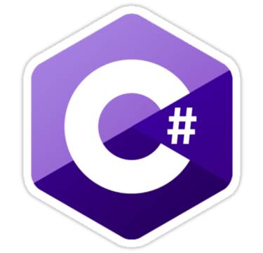
C# - Examples of programming languages
 | Compiled or Interpreted? | Compiled
 | Common uses | Server-side web development via ASP.NET/Razor/Blazor Game development via Unity/Godot/Stride Developing applications with a look and feel of the Microsoft Windows/Windows Phone operating system using Windows Forms, Windows Presentation Foundation (WPF), Universal Windows Platform (UWP) Creating a database managed system via Microsoft SQL Server/MySQL
 | Developer | Microsoft (as part of the .NET framework initiative)
 | First appeared | 2000

Slide 10

JavaScript - Examples of programming languages
 | Compiled or Interpreted? | Interpreted
 | Common uses | Hybrid mobile applications development, assisting HTML alongside CSS and mobile-first frameworks such as Ionic/Bootstrap. Online game development Developing desktop applications alongside HTML and CSS. Modifying/adding/removing HTML elements.
 | Developer | Brendan Eich
 | First appeared | 4 December 1995

Slide 11

Python - Examples of programming languages
 | Compiled or Interpreted? | Interpreted
 | Common uses | Task automation Web-scraping via Beautiful Soup Web development using Flask Machine learning Scientific and mathematical computing Embedded systems via Raspberry Pi/Arduino
 | Developer | Guido van Rossum
 | First appeared | 20 February 1991 (development first started in December 1989)

Slide 12

Java - Examples of programming languages
 | Compiled or Interpreted? | Both (.java source code is compiled to binary (0’s and 1’s) and then the Java Virtual Machine, an interpreter, is required to execute the binary)
 | Common uses | Native mobile/tablet applications development via Android Studio, although Kotlin is more preferred nowadays for Android development. Web scraping via Selenium Web development via JSP Developing GUI applications with a look and feel of the Windows operating system. Game development
 | Developer | James Gosling
 | First appeared | 23 May 1995 (development first started in June 1991)

Slide 13

PHP - Examples of programming languages
 | Compiled or Interpreted? | Interpreted
 | Common uses | Development of Content Management Systems such as WordPress. Interacting with forms (sending data via email automatically), as well as databases via MySQL and the native file system. Accessing cookie variables and setting cookies programmatically. Handling user authentication.
 | Developer | Rasmus Lerdorf
 | First appeared | 1995 (development first started in 1994)

Slide 14
Getting started
Please launch your preferred text editor (such as Brackets, Atom or Visual Studio Code). From my end, I will be henceforth using Visual Studio Code. To see how to install a text editor, please refer to the previous session. You need not run the text editor with administrator privileges.
Support for Brackets is phasing out; thus support (software updates and new features) will no longer be available after 1st September 2021. I thus recommend you switch to Visual Studio Code or Atom. I prefer Visual Studio Code to the latter as extensions such as autosave and Emmet (speeding up the workflow pertaining to HTML and CSS) are built-in. We only needed to set up Live Server.

Slide 15
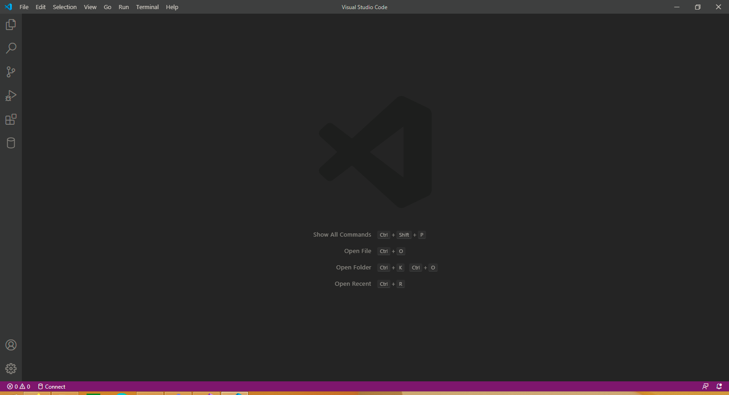
Creating our first HTML project
Expand the first button from the sidebar, then press Open Folder. Alternatively, you may select File from the menu strip, then press Open Folder. You may also use the following key combination: Ctrl+K Ctrl+O (Press Ctrl together with the K and O simultaneously).
If you disabled the option to show the Welcome page on startup, then your layout of Visual Studio Code will look like the screenshot on the left-hand side.

